Slide 1
Class Diagram / Object Oriented Analysis

Slide 2
Class diagram
Class diagram describes the structure of a system by presenting the system's classes, objects, their attributes, operations (or methods), and the relationships among objects.
Class diagram depicts the static overview of the system
Class diagram shows the object oriented analysis of the system
Class diagram is the base for showing the components of the software system.
Class diagram helps in reverse engineering process

Slide 3
Importance of object oriented Analysis
Software requirements Analysis
Designing of software
Become the base for programmers

Slide 4
Pieces of an Object Model
Classes type: It shows particular class name with specific defined goal
Relations: Relation of one class object with other class object
Attributes: class is defined over its unique attributes or characteristics such as student_id, name, address are attributes for class student.
Operations: operations are the specific detail functions of a class

Slide 5
Types of Relationship
Simple association
Directed association
Aggregation
Composition
Dependency
Generalization

Slide 6
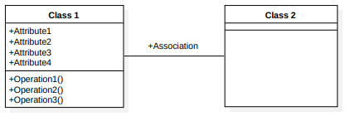
Association
Association is used to describe that one object can be associated with another object or link between two classes. This doesn’t mean both depends on each other but only associated in bidirectional way. E.g.

Slide 7
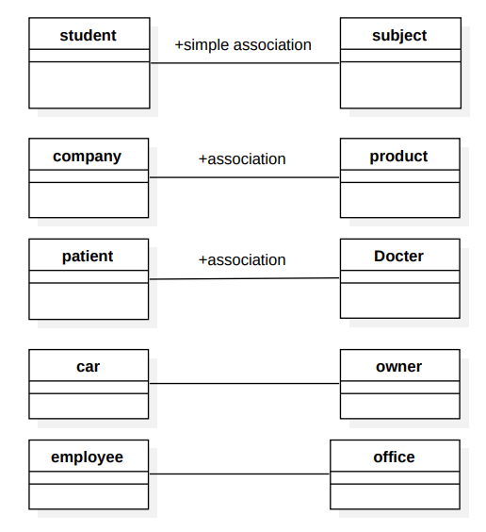
Examples of association

Slide 8
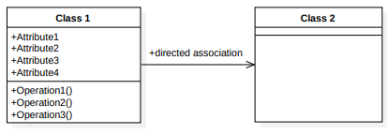
Directed Association
An association relationship is bilaterally by default, but a directed association shows flow of control or dependency in one direction. Here one class does not depend on other class but can be associated with it

Slide 9
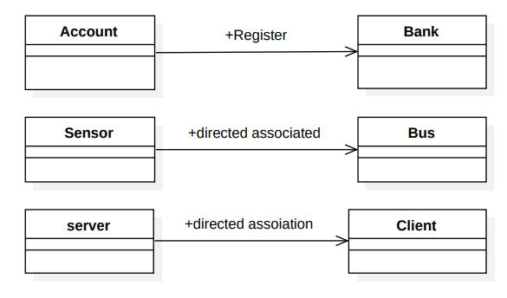
Examples of Directed Association

Slide 10
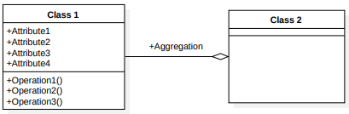
AGGREGATION
in aggregation, target class is a part of source class.
In aggregation, two classes loosely combine for some task. This means, two classes in aggregation can exist independently.

Slide 11
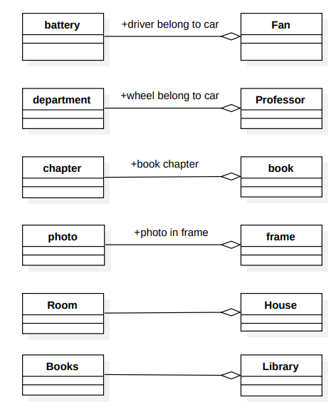
Examples of Aggregation

Slide 12
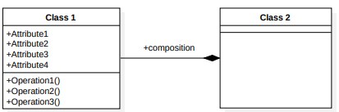
Composition
Two classes in strong couple such that both classes can not exist independently.
Two classes strongly combine for single cause.
Target class is a part of source class

Slide 13
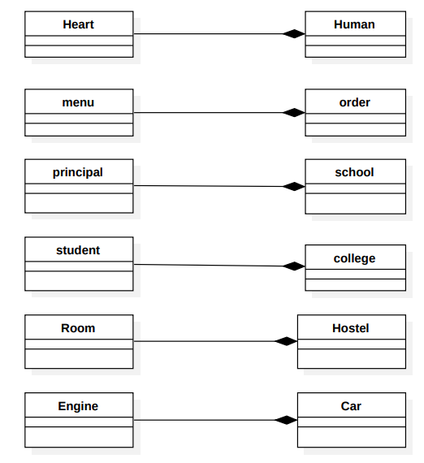
Examples of Composition classes

Slide 14
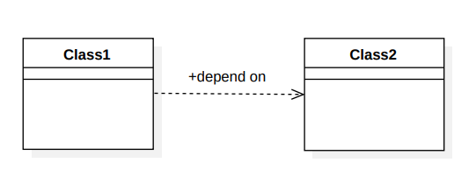
dependency classes
It is a relationship in which one class depends on other class
Execution of one class depends on another class

Slide 15
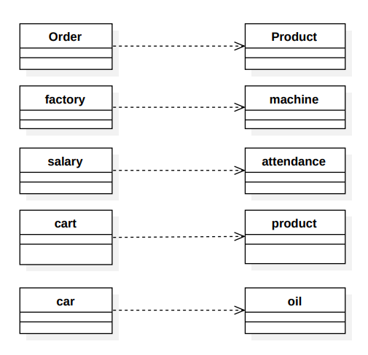
Examples of dependency classes

Slide 16
Generalization
One or more child inherit property from parent class
Here we makes on class as generic or parent and rest as child classes
Generalization limits repetition of attributes and operations

Slide 17
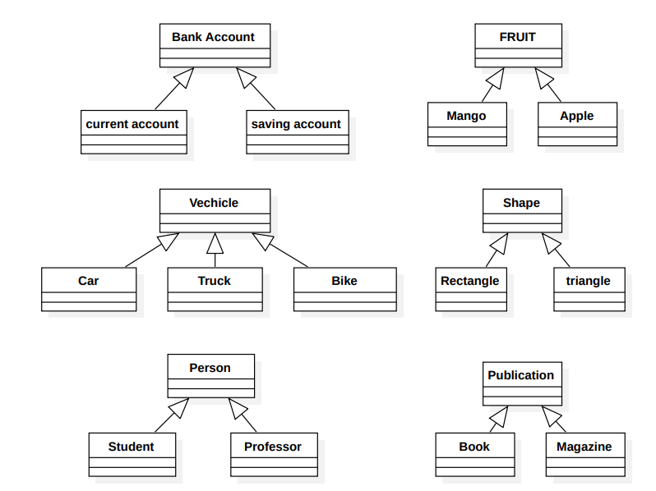
Generalization Examples

Slide 18
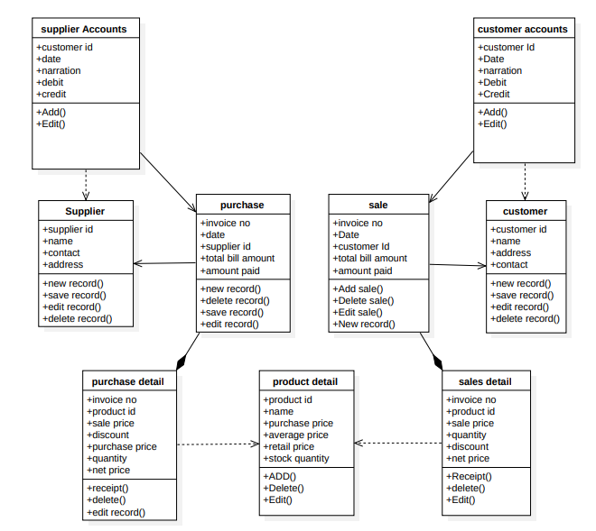
Class diagram for point of sale

Slide 19
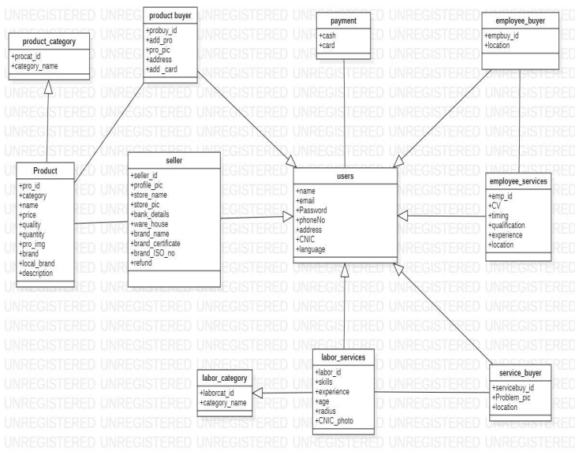
Service and product provider web application

Slide 20
Associative Class
Associative class produce association of two other classes.
Some times, relation of two classes is meaningless with introducing some associative class. E.g. relation of student and course. Here, this relation can be either attendance, exam, enrolment etc.

Slide 21
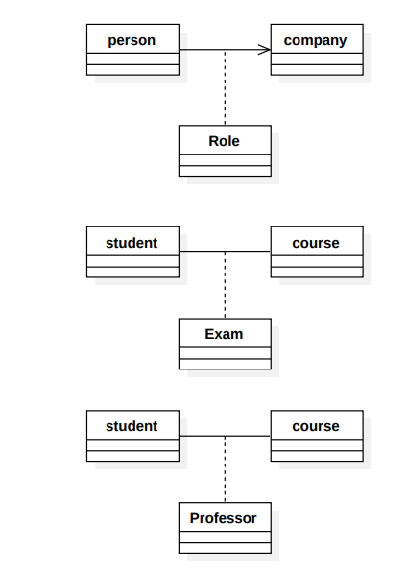
Associative Class Examples

Slide 22
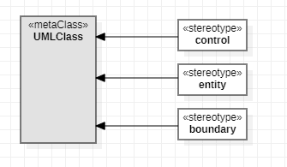
Object Types
Entity Objects
Represent the information tracked by the system (Application domain objects, “Business objects”)
Boundary Objects
Represent the interaction between the user and the system
Control Objects:
Represent the control tasks performed by the system

Slide 23
Example: Watch Objects
Year
Button
ChangeDate
Month
LCDDisplay
Day
Entity Objects
Control Objects
Interface Objects

Slide 24
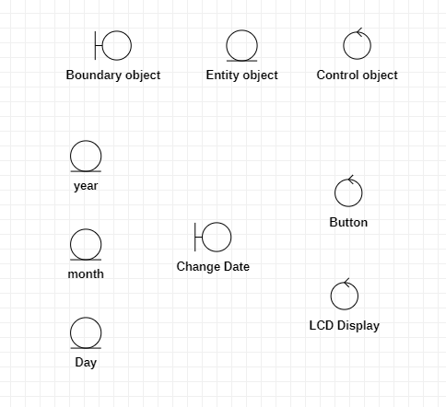
Icons for Stereotypes

